Slide 1
Discussion 3
Yi-An Li
20180213

Slide 2
Outline
Noise Sim.
Exercise on Noise

Slide 3
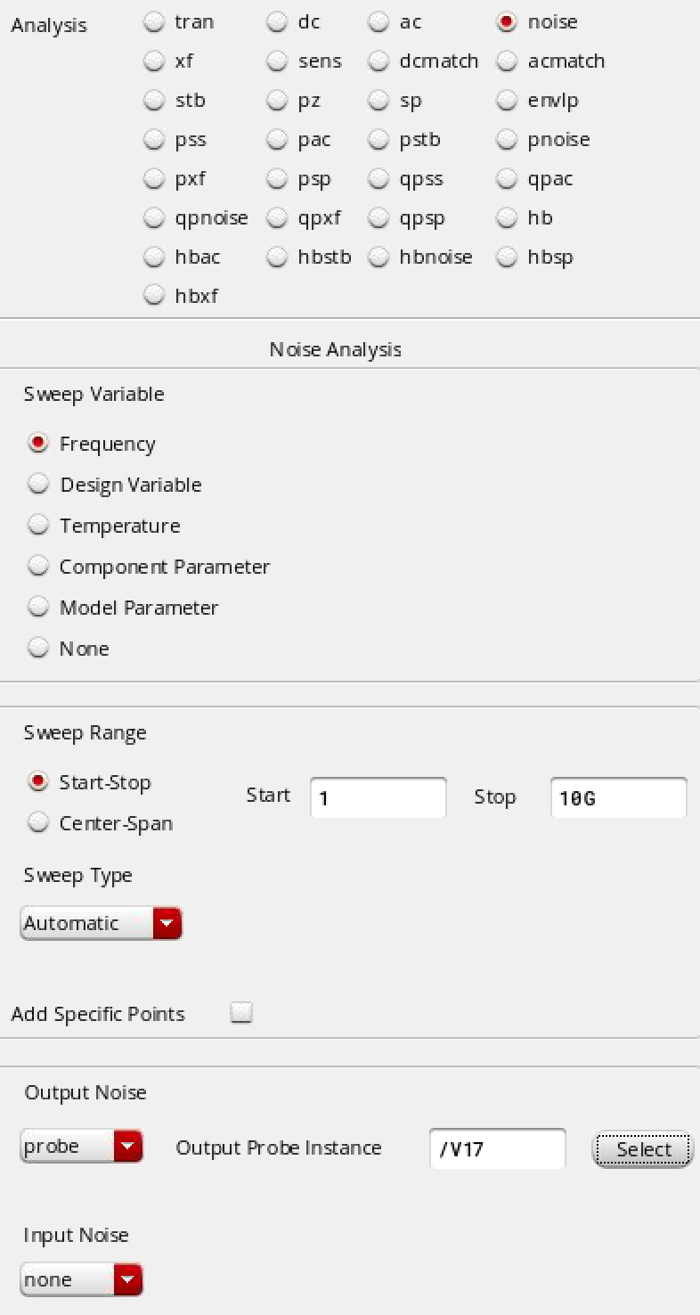
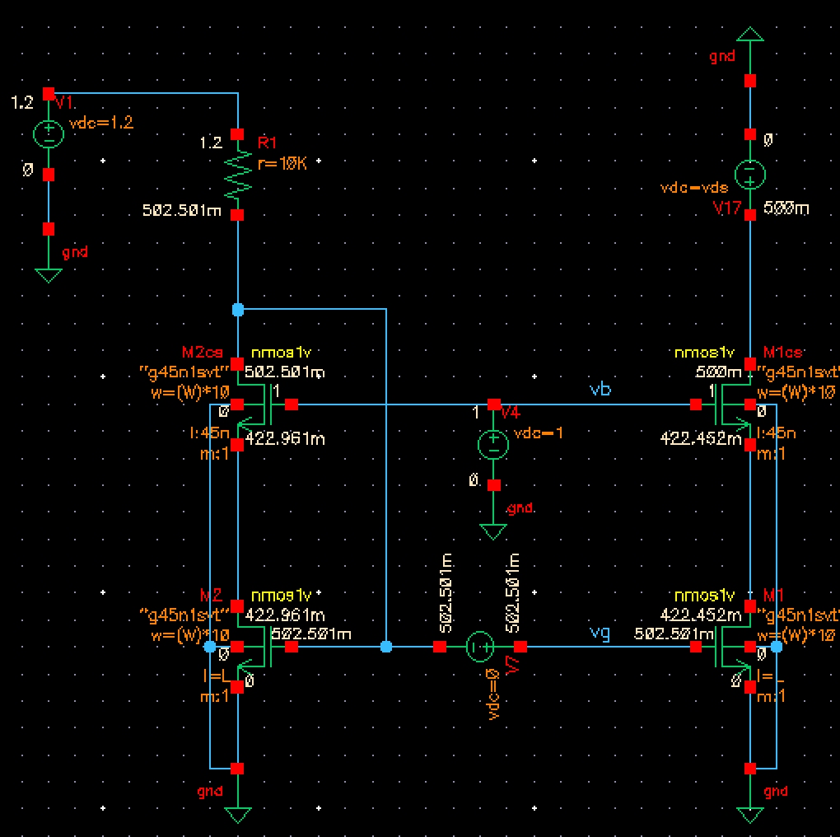
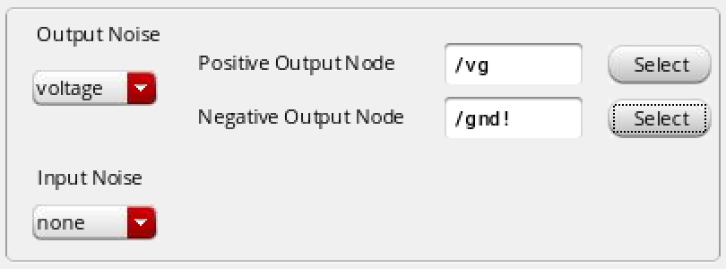
Noise Sim.
Ex: Current Mirror
For current noise
For voltage noise

Slide 4
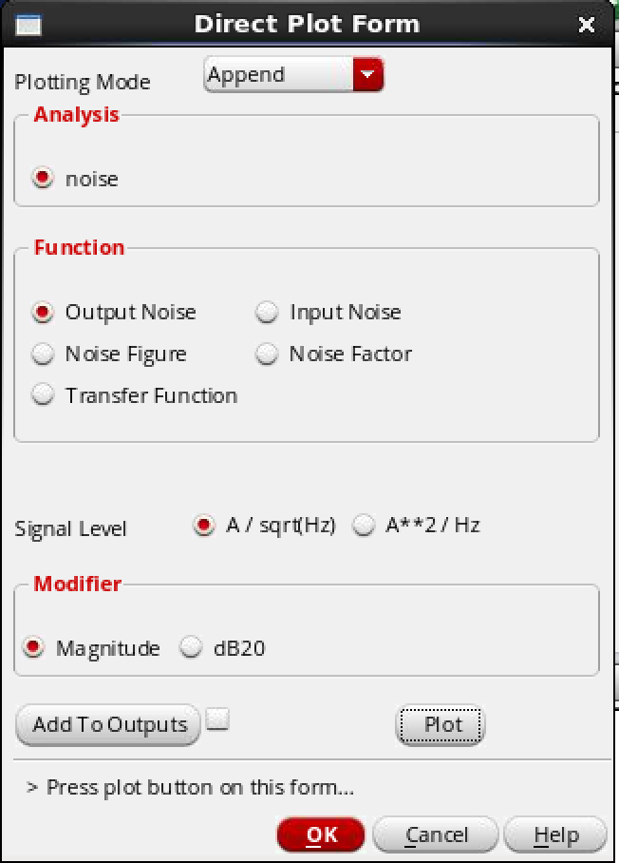
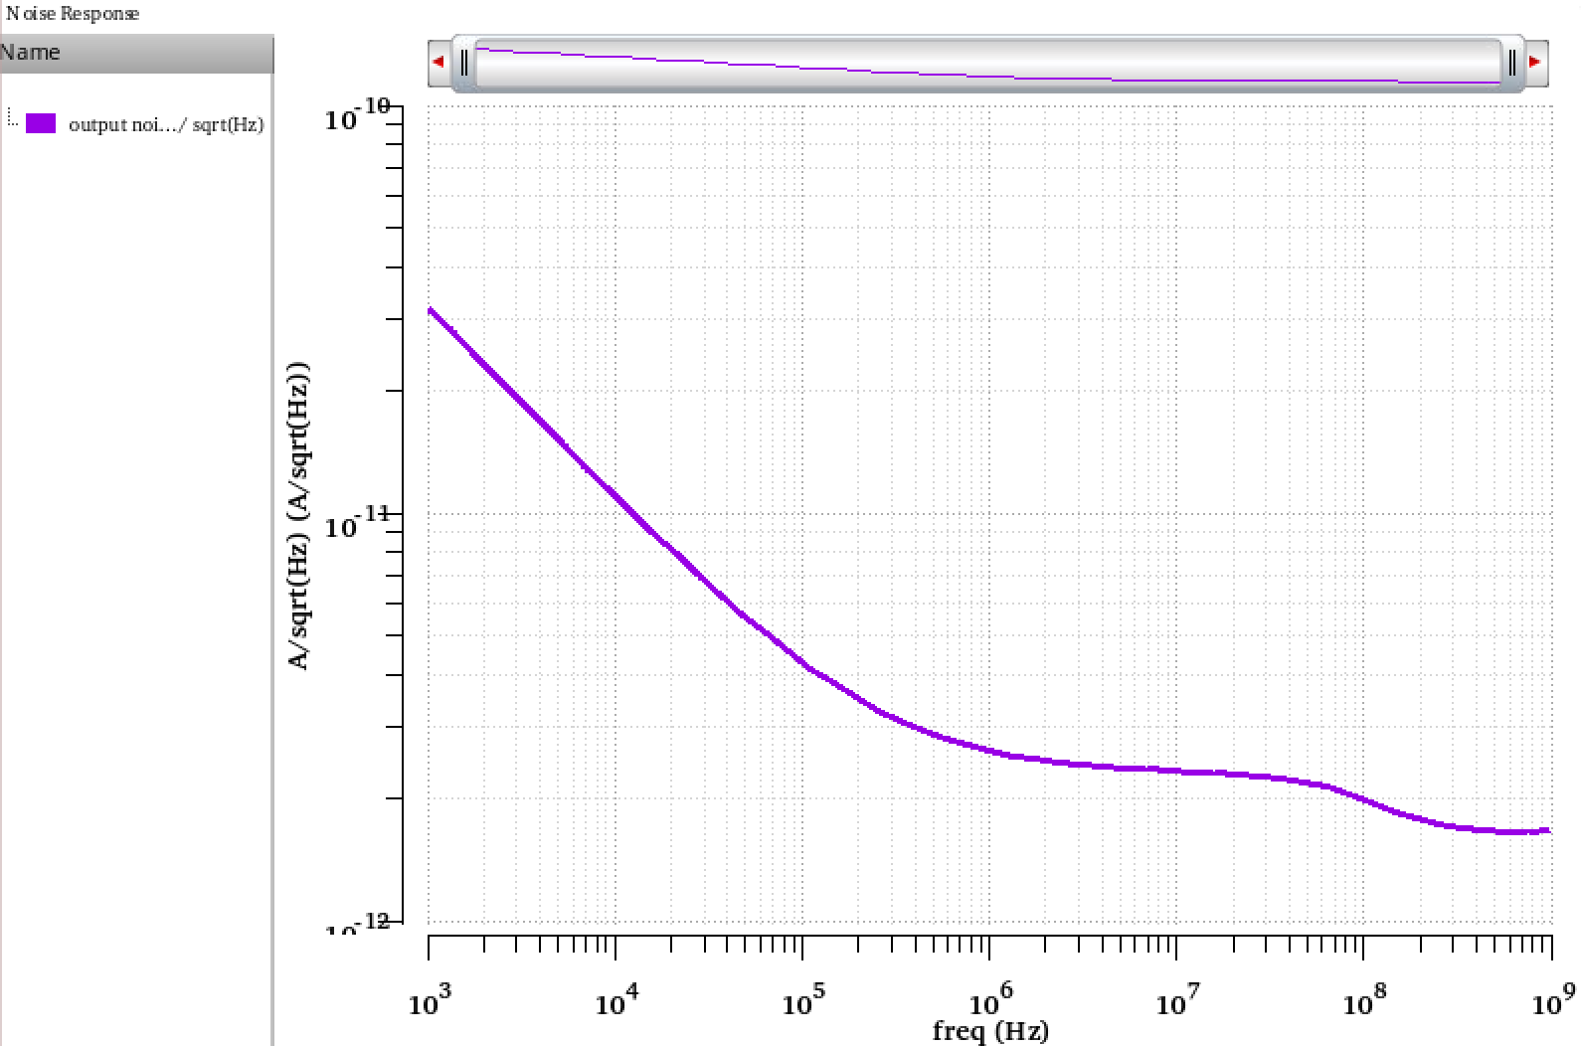
Noise Plot

Slide 5
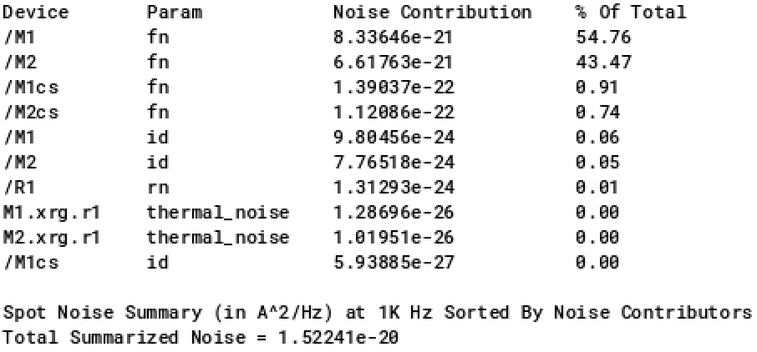
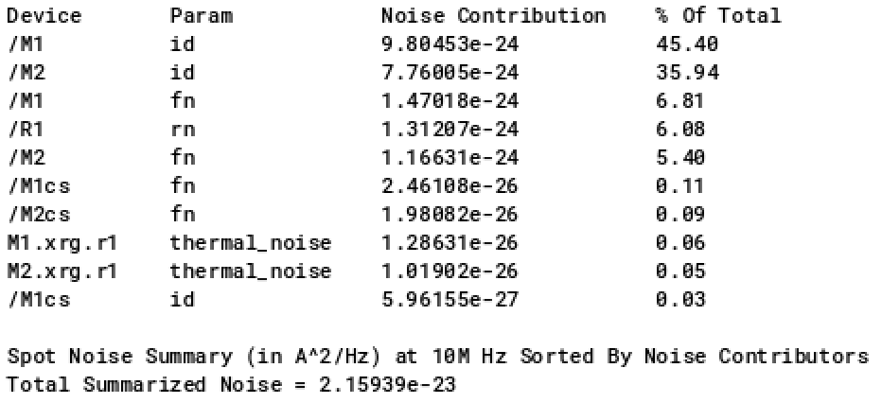
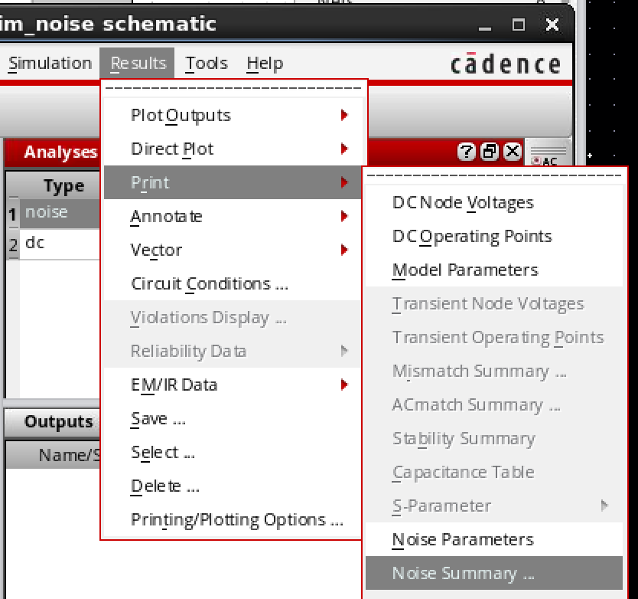
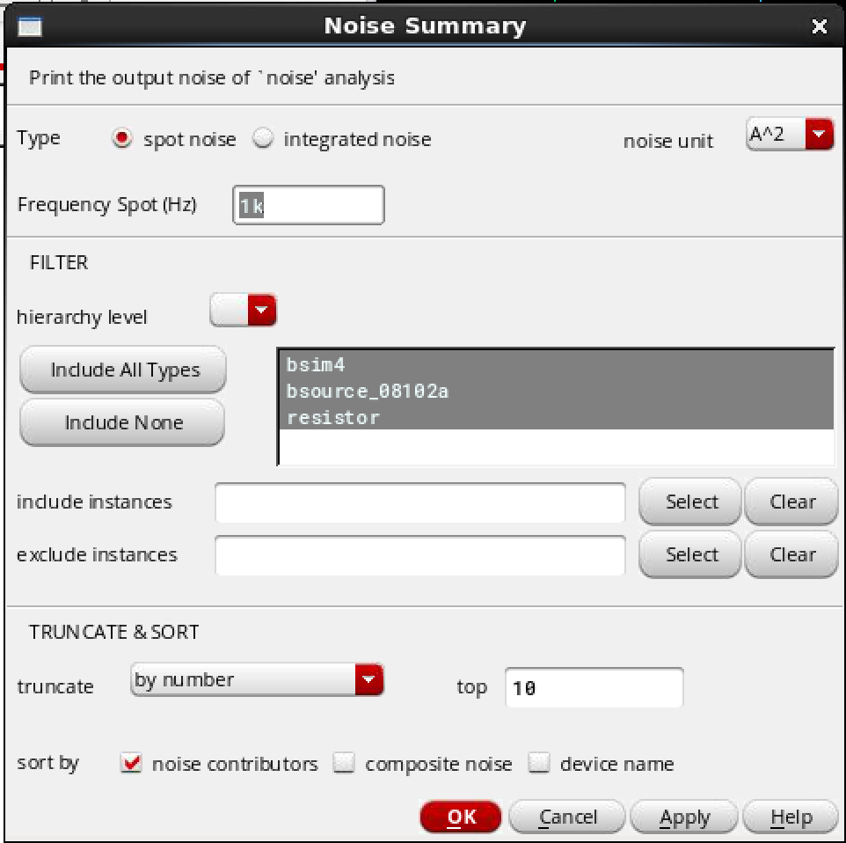
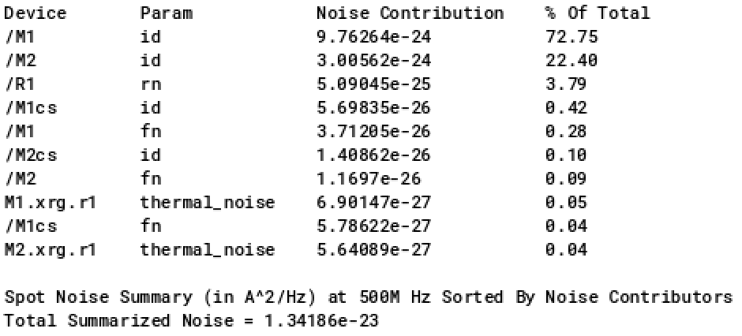
Noise Summary
id : transistor noise
fn : flicker noise
rn : resistor noise

Slide 6
Noise Summary
id : transistor noise
fn : flicker noise
rn : resistor noise
M2cs (2u/45n)
M1cs (2u/45n)
M2 (2u/1u)
M1 (2u/1u)

Slide 7
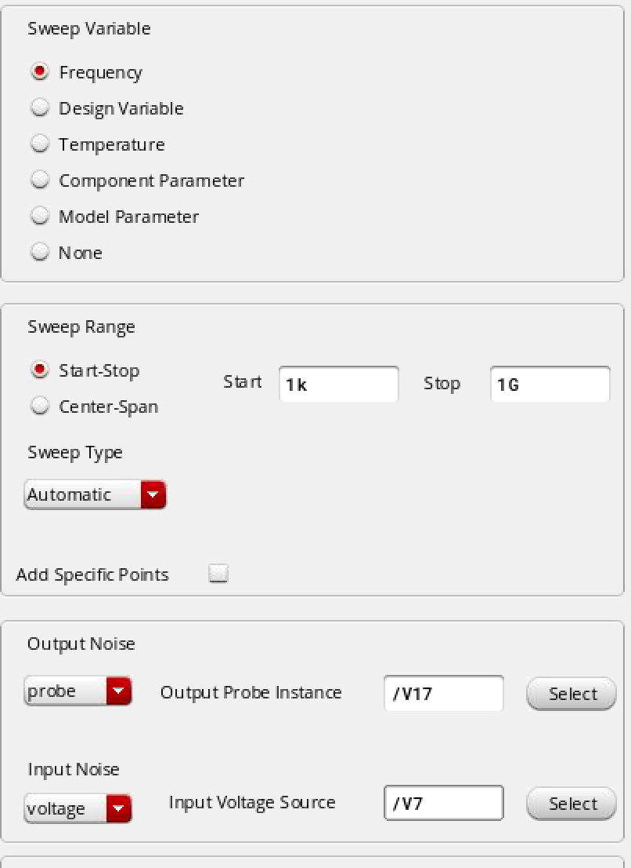
Input Referred Noise
Output noise (I) refer to input (V).

Slide 8
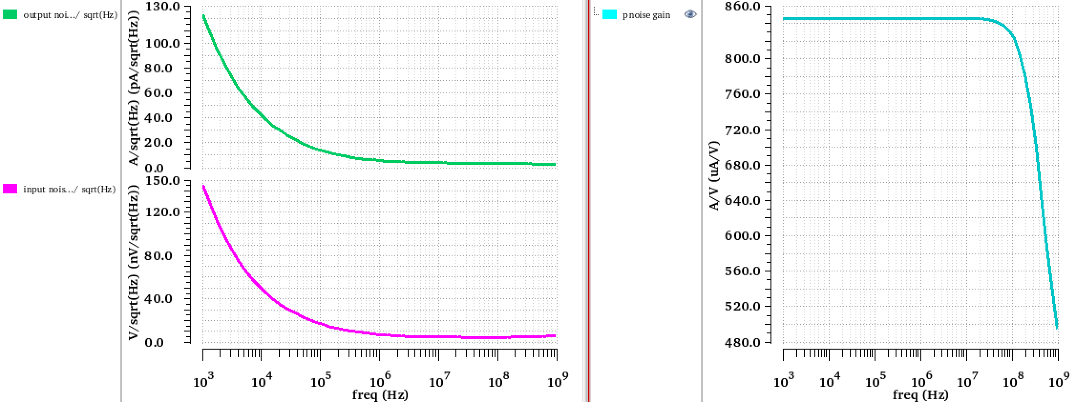
Noise Plot
NTF = g_{m}
Output current noise
Noise transfer function
Input referred voltagenoise

Slide 9
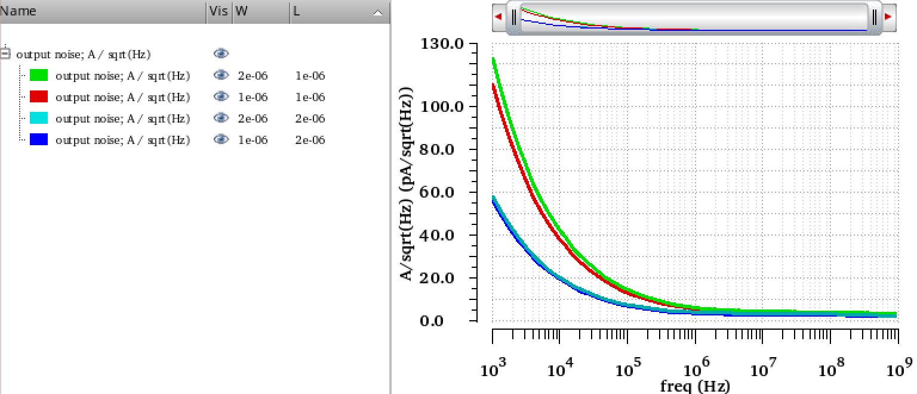
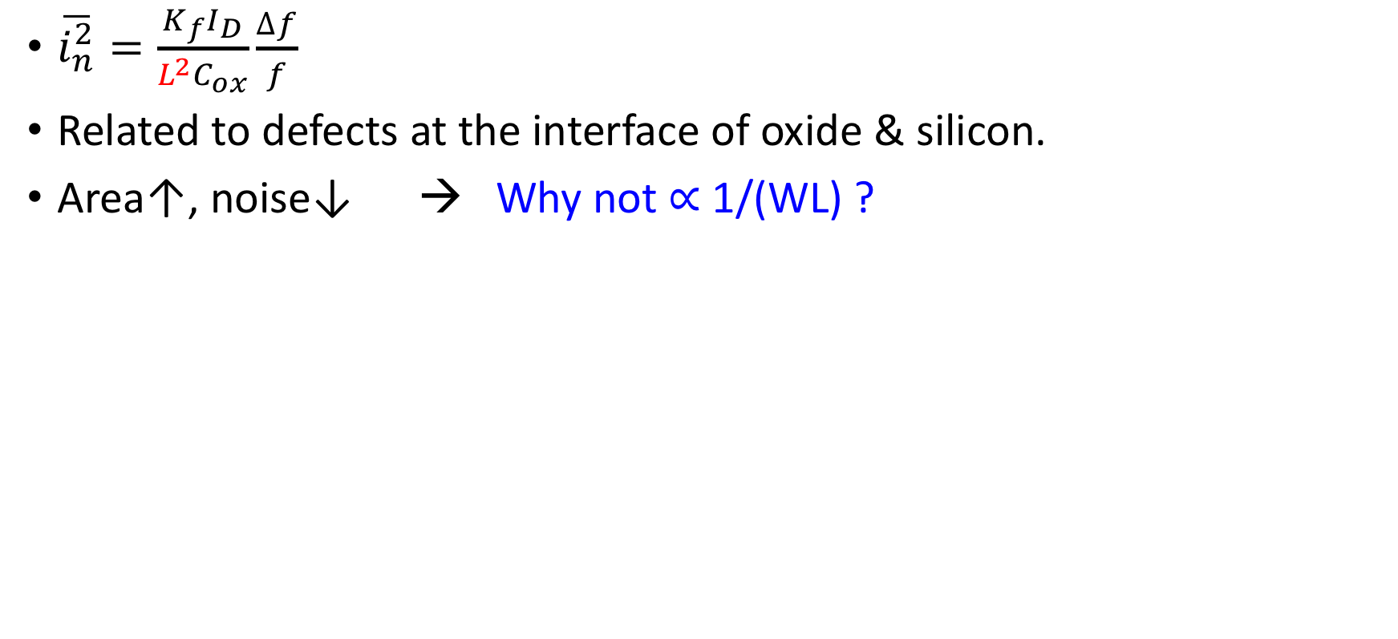
Flicker Noise
$\overline{i_{n}^{2}}=\frac{K_{f}I_{D}}{L^{2}C_{ox}}\frac{∆f}{f}$
Related to defects at the interface of oxide & silicon.
Area↑, noise↓ → Why not ∝ 1/(WL) ?
W=2u L=1u W=1u L=1u W=2u L=2u W=1u L=2u
Output current noise

Slide 10
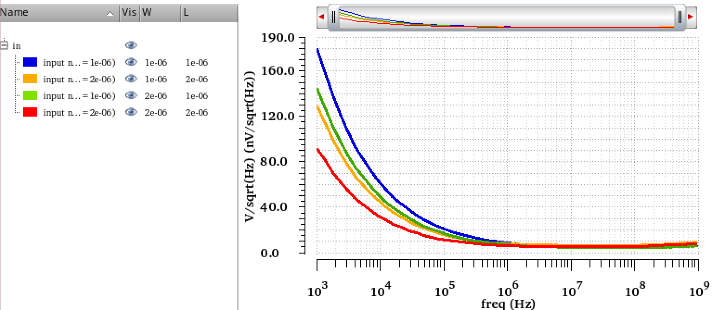
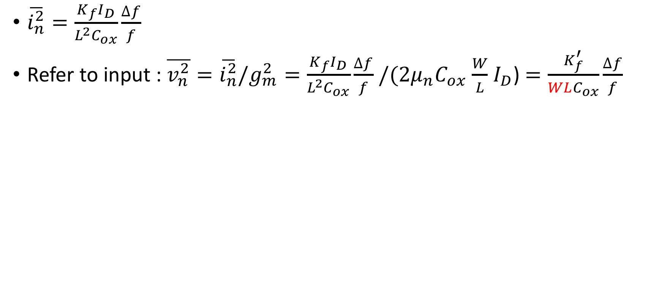
Flicker Noise
$\overline{i_{n}^{2}}=\frac{K_{f}I_{D}}{L^{2}C_{ox}}\frac{∆f}{f}$
Refer to input : $\overline{v_{n}^{2}}=\overline{i_{n}^{2}}/g_{m}^{2}=\frac{K_{f}I_{D}}{L^{2}C_{ox}}\frac{∆f}{f}$ $/{{(2μ}_{n}C}_{ox}$ $\frac{W}{L}$ $I_{D}$) $=\frac{K_{f}^{′}}{WLC_{ox}}\frac{∆f}{f}$
W=1u L=1u W=1u L=2u W=2u L=1u W=2u L=2u
Input referred voltage noise

Slide 11
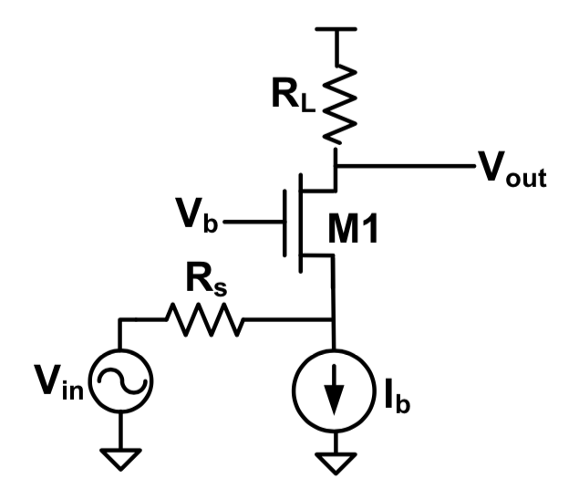
Noise
Find the output SNR when R_{S}=R_{in}(consider only noise due to M₁, Amp(V_{in})=A, V_{out} is loaded by C_{L}, ignore r_{o})
R_{in}

Slide 12
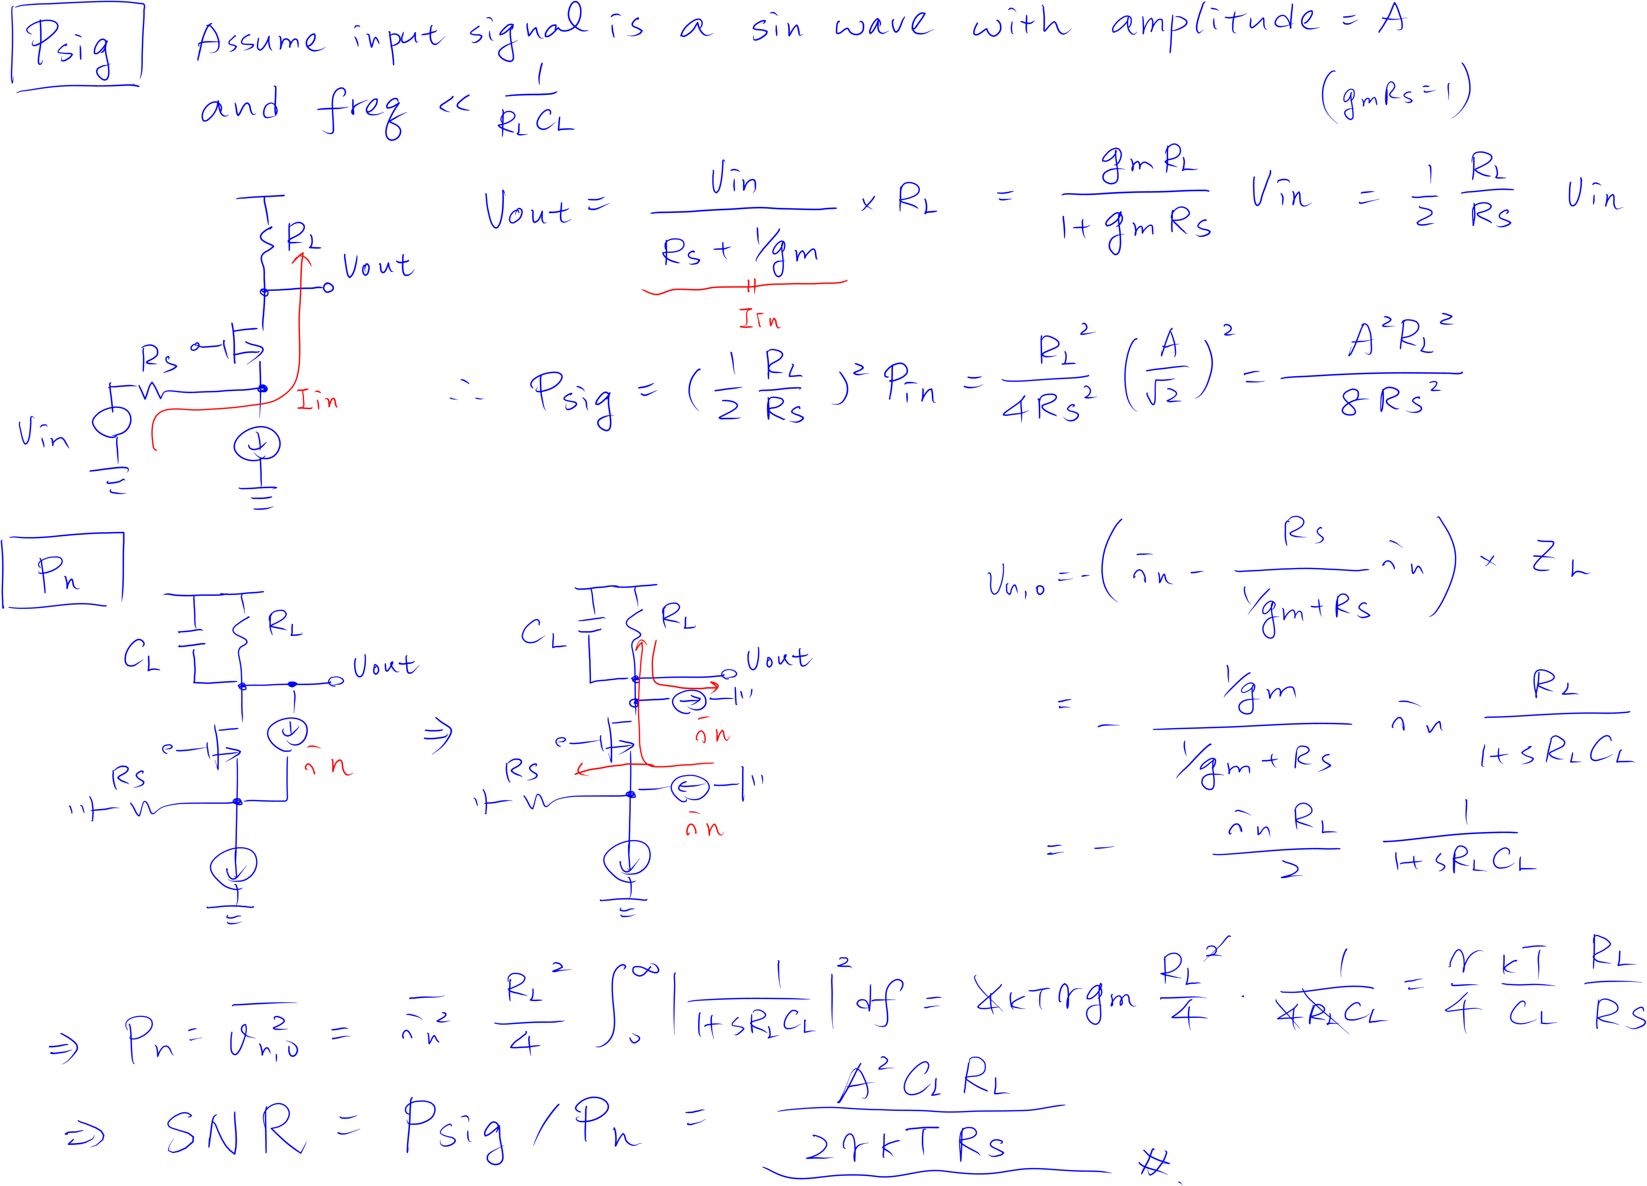

Slide 13
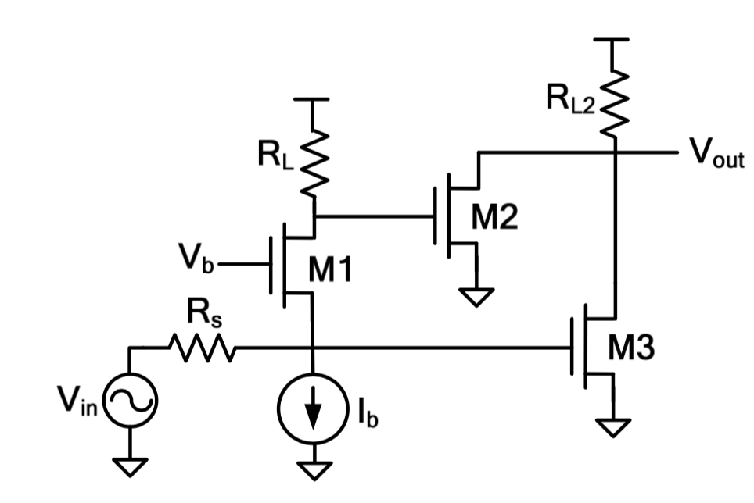
Noise
Find the output SNR when R_{S}=R_{in}& g_{m2}R_{L}=g_{m3}R_{S}(consider only noise due to M₁, Amp(V_{in})=A, V_{out} is loaded by C_{L} , ignore r_{o})
R_{in}

Slide 14
